Slide 1
HP optical Mouse

Slide 2
contents
Introduction
Product overview
Internal construction
Functional block diagram
Tinkercad simulation
Conclusion

Slide 3
INTRODUCTION
Our project is based on the reverse engineering of an HP optical mouse.
We studied the mouse from both the external and internal point of view.
The main focus is on its mechanical structure, electronic components, working principle and simulation.

Slide 4
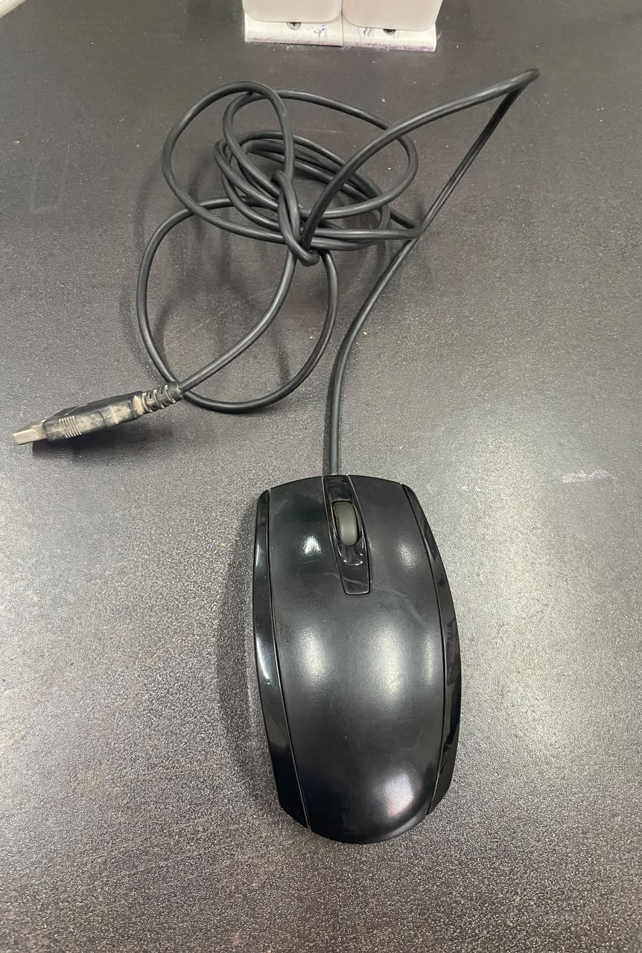
Product overview & external features
The mouse has left and right buttons and a scroll
wheel.
It uses a USB cable for connection with the computer.
The outer plastic casing protects the internal
components.
The design is compact and made for comfortable
hand movement.

Slide 5
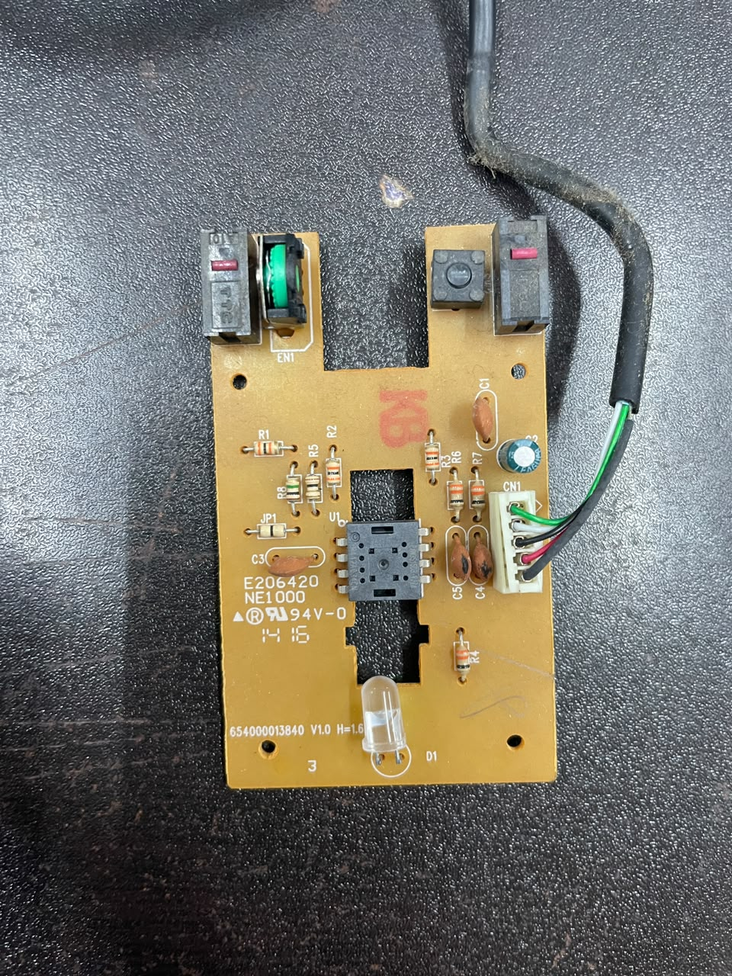
Internal Construction & PCB
After opening the mouse, we can see the PCB and mechanical components.
The PCB contains the controller IC, resistors, capacitors, connector and LED/diode components.
The mouse also contains microswitches and a rotary encoder.
The controller processes the signals coming from these components.

Slide 6
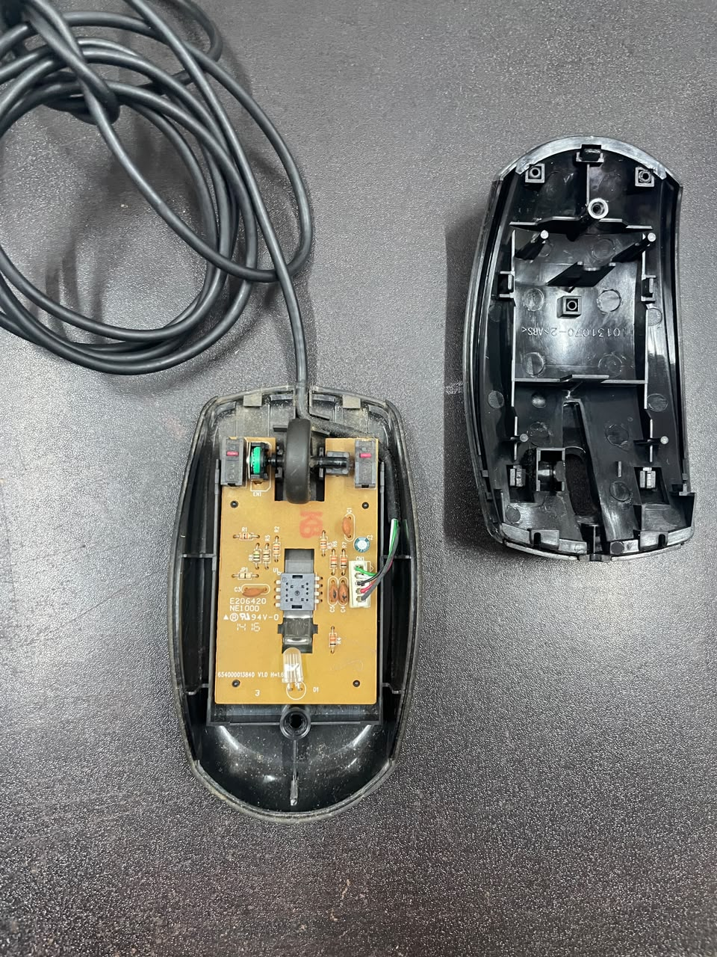
Functional block diagram
Movement of a mouse
Mouse moves over a surface
LED/ Optical Light Source
Illuminates the surface
Lens and optical sensor
Captures successive surface images
IC/ Microcontroller
Calculates movement in X and Y directions.
USB interface
Transmits movement and button data
Computer
Moves the cursor on the screen.

Slide 7
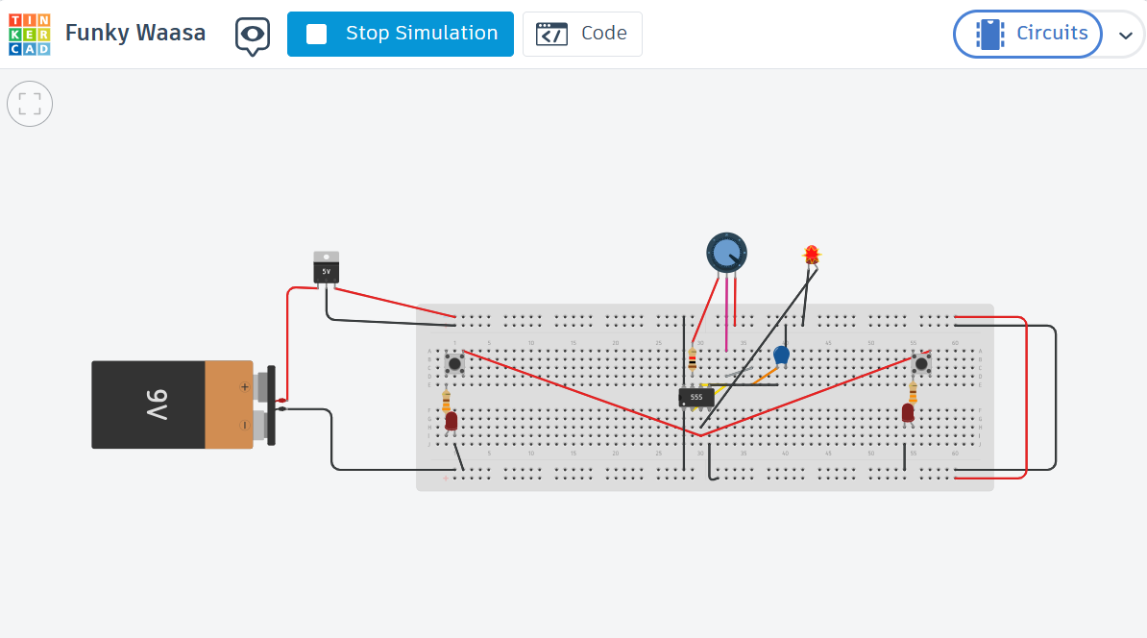
Tinkercad simulation

Slide 8
conclusion
By examining the mouse, we identified its major parts including the optical sensor, LED, PCB, switched and USB interface.
We studied how optical sensor detects movement and how the IC processes the signals to control cursor movement on the screen.

